Slide 1
A Long Way to the Top:
Significance, Structure, and Stability of Internet Top Lists
By Quirin et. al
Presented by Ryan West

Slide 2



Internet Top Lists
Rank the most-visited websites by various criteria
Our focus: Top million website lists
Notes:
There are lots of types of lists such as category-based lists for certain markets and different sizes of lists, most of which are paid. We only consider three Top 1 million lists.
Alexa and Majestic both use web links; Umbrella uses DNS traffic
“Umbrella is capable of capturing domains from any device using OpenDNS, such as mobile and IoT devices, and also include domains users are not aware of visiting, such as embedded third-party trackers in websites”
“Alexa and Majestic provide a web-specific picture of popular Internet domains”

Slide 3
Paper Overview
Significance of Top Lists
Structure Comparison
Stability Comparison
Ranking Mechanisms
Top Lists vs General Domains
Recommendations
Notes:
Recommendations are for both users of top lists and for the top list providers

Slide 4
Significance of Top Lists
Searched 687 network research papers from 2017
69 use top lists (10%)
Are paper results dependent on top lists? Yes (45/69)
Are studies replicable? No
Only 2 papers give list download and measurement dates
Notes:
44 of 45 papers are dependent on Alexa Top 1M specifically in their results
These 2 questions make it clear that top lists are significant; other research results depend on the lists at that point in time

Slide 5
Dataset
Studied Alexa 1M, Cisco Umbrella 1M, and Majestic Million
Daily snapshots from all lists taken to form a JOINT dataset
June 2017 – April 2018
Notes:
I’m not sure why JOINT is capitalized throughout the paper

Slide 6
Domain Name Coverage
1543 TLDs total, but only ~700 TLDs in dataset (May 2018)
Valid TLDs in Top 1K Lists:
Alexa: 105
Majestic: 50
Umbrella: 13
72% of Umbrella list are subdomains
Alexa and Majestic are almost entirely base domains (exception: blogspot)
Notes:
Why does Umbrella top 1K have so few TLDs? “We speculate that this is rooted in DNS administrators from highly queried DNS names preferring the smaller set of professionally managed and well-established top-level domains over the sometimes problematic new gTLDs”
No invalid TLDs occur in alexa and very few in Majestic, but a few more do in Umbrella: “early indicator of specific characteristic in the Umbrella list: invalid domain names queried by misconfigured hosts or outdated software can easily get included into the list.”

Slide 7
Intersection between Lists
How many domains are shared between lists?
Majestic ⟷ Alexa | 285k then 240k
Majestic ⟷ Umbrella | 113k
Umbrella ⟷ Alexa | 150k
Majestic ⟷ Umbrella ⟷ Alexa | 99k
Notes:
Starting end of January 2018, intersection of Magestic and Alexa was reduced to 240k which also introduced a weekly pattern for Alexa. Likely due to Alexa changing its 3-month sliding window

Slide 8
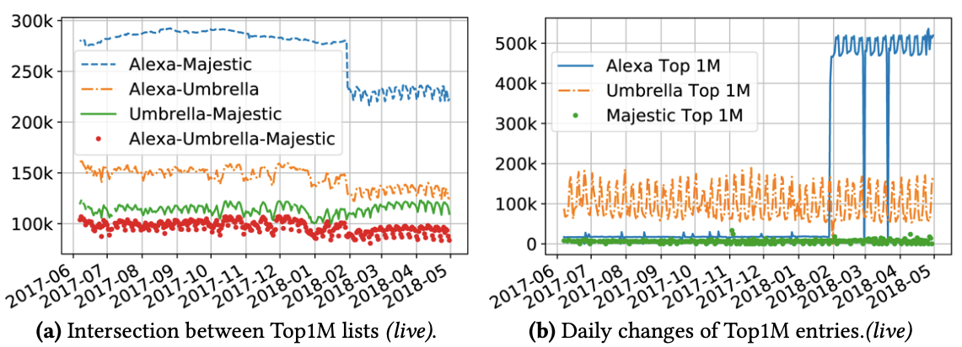
Stability: Daily Changes
Notes:
(Right figure) Majestic is the most stable list with ~6k changes / day, Umbrella is ~118k/day, and Alexa used to be 21k/day but changed to ~483k/day in 1/18.
All lists show an average of 20-33% of daily changing domains to be new domains, so 66-80% are repeatedly removed and reinserted into a list.
90% of domains in Alexa 1M are in list for 50 or fewer days, but 40% of domains in Majestic remain for the full year
Majestic is the most stable

Slide 9
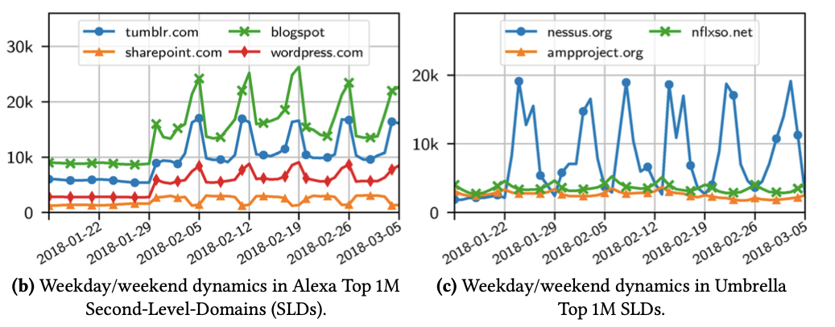
Stability: Weekly Patterns
Notes:
Majestic isn’t generally included here because it does not have weekly patterns (more stable)
Graph shows some second level domains that vary by more than 40% between weekdays and weekends.
Left graph shows an increase in weekend traffic for three sites but a decrease in sharepoint.com (often used for work)
When measuring rank correlation using Kendall’s rank correlation coefficient, they also find that “The difference of variability between top and bottom domains is striking and in line with our previous findings: the ranks of top domains are fairly stable, while the ranks of bottom domains (bottom of the 1M) vary drastically.”

Slide 10
Ranking Mechanisms
Top lists can be unstable from day to day
How does each list determine rankings?
Can this ranking be manipulated?

Slide 11
Ranking Mechanisms
Alexa
Gathers page view stats via “25k+ browser extensions”
Very secretive
Umbrella
Counts DNS queries through the OpenDNS public resolver
Represent automated queries more than human-entered URLs
Rank determined from number of clients, not query volume per client
Majestic
A custom web crawler counts links by # of referring /24-IPV4 subnets, not individual IPs
Uses last 90 days of data
Notes:
There is an Alexa toolbar mentioned that is installed but the paper doesn’t go into detail. The paper is unclear when or where this toolbar is installed, and if it exists on everyday devices
Majestic reacts slowly to domain closure since it uses the last 90 days

Slide 12
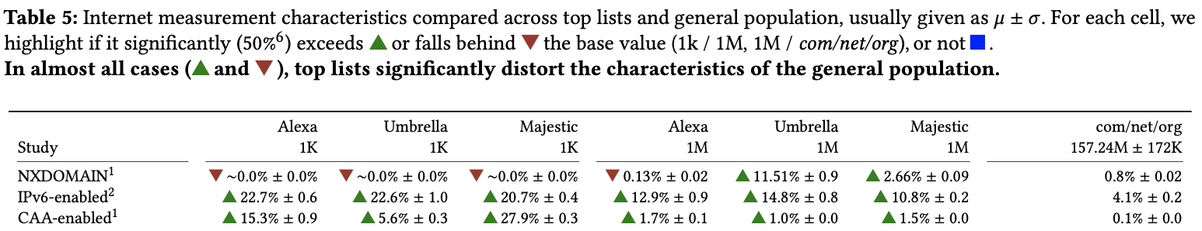
Top Lists vs General Domains
(HTTP Strict Transport Security)
Notes:
I’m selecting only a few of their observations and graphs to discuss, but there are many more
HTST is a current research topic at the time of the paper, stands for HTTP Strict Transport Security
One thing I wasn’t sure about was how they got the domains for com/net/org and tested them

Slide 13
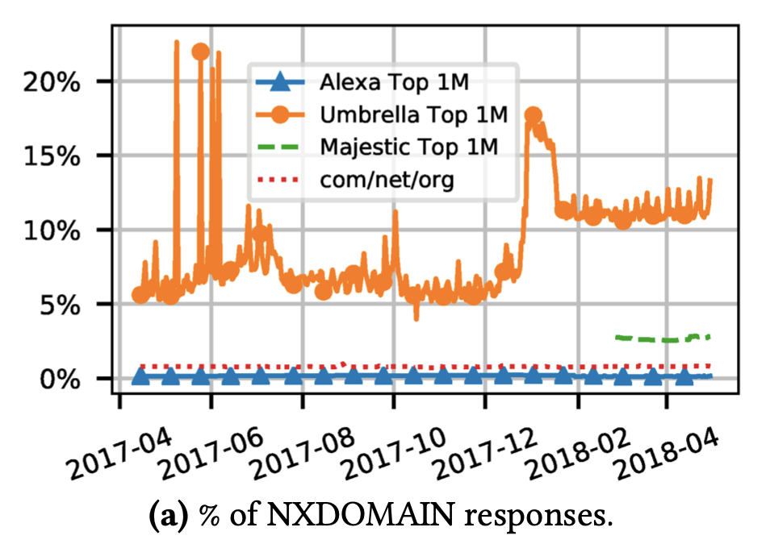
Top Lists vs General Domains: NXDOMAIN
Notes:
This graph shows how Umbrella varies incredibly as well as Majestic in 2018

Slide 14
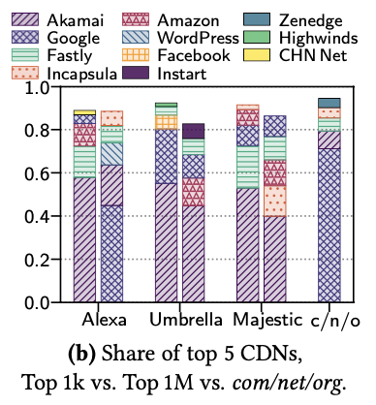
Top Lists vs General Domains: Top CDNs
Notes:
The Google CDN is underrepresented in Umbrella and Majestic and shows that each top list is very different

Slide 15
Top Lists vs General Domains: Takeaway
Top lists have extreme measurement results (i.e. HSTS usage magnified)
2 orders of magnitude more for Top 1k domains
Results affected by daily and weekly patterns
Huge variation between lists shows they do not necessarily represent the general state of the Internet
Notes:
One-off uses by measurement studies may result in getting skewed data that has been altered by that day’s traffic

Slide 16
Recommendations for Top List Use
Match choice of list to study purpose
Umbrella better for DNS traffic, Alexa for human behavior
Conduct repeated measurements for added stability
Document list and measurement details
Allows for replicability

Slide 17
Desired Properties for Top Lists
Consistency
Ranking process and structure should remain the same
Announce and document any changes
Transparency
Providers should be transparent about their ranking process and biases
Might contradict business interests
Stability
Offer long-term and short-term lists
Notes:
Transparency example: Alexa changed significantly at the end of January 2018 but didn’t report any differences
Long-term lists could be a 90-day sliding window, whereas short-term would only uses the most recent data

